Slide 1
Project Week Kick-off
January 5th, 2024

Slide 2
Model Compression:
Solving Real-world Challenges in AI for Customer Care

Slide 3
Our ML theme is model “compression”
Foundation models – large, complex deep neural networks that can effectively perform a broad range of tasks (e.g., GPT-4, PaLM, Gemini) – are a revolution in AI, but can be costly to use and maintain – difficult to justify when smaller, less costly models are as performant and only a more specific task is needed.
However, gold-standard labels are not always available for specific tasks.
Knowledge distillation is a category of machine learning approaches aimed at compressing the capabilities of a complex and large neural network into a smaller and simpler model.
Large “teacher” model
Data
Smaller “student” model
Your challenge: train a text classifier to mimic the output of a zero-shot classification from a foundation model
Notes:
Note: this isn’t true KD in the sense we’re training a student model to mimic the soft outputs of a larger model

Slide 4

Our application: intent detection to improve customer care
Our domain for this challenge is customer care.
The text to classify consists of transcripts of telephone conversations between call center agents and customers
The classification target is the reason for the call – root cause / customer intent, e.g.:
Product availability inquiry
Schedule repair
Change or update order
LABEL
Text classification means assigning discrete labels to spans of free-form, natural language text. Examples include sentiment analysis, topic detection, tagging, etc.
An example:
Transcript:
Label:
“… its ringing on my phone but its not ringing in the house when i hit the doorbell… it worked for the test when we did the test but it doesnt work when i hit the doorbell..”
Encoding / feature extraction
Troubleshooting
Model

Slide 5
The data themselves pose unique challenges.
We’ve already performed the zero-shot classification with GPT 3.5; you’ll only need to train a classifier to mimic these outputs.
~350k interactions, which you can split into train and validation sets.
A test set will be released later in the week for final evaluation
Two columns only:
Text from interaction
The label itself
57 unique labels
Your main concerns and challenges in dealing with these data will be:
We’ve already performed the zero-shot classification; you’ll train a classifier to mimic these outputs.
The labels provided are not 100% reliable
An excellent solution will adjust for the uncertainty of the ground truth
The ‘correct’ label may not always be among those provided
The quality of transcription varies a lot
Advanced pre-trained encoders may or may not be effective
Simpler approaches (e.g., TF/IDF vectors into SVM) may do as well or better

Slide 6
You’ll be evaluated on multiple criteria.
Quality of the model, work product.
Quality of your final presentation
Accuracy a major component, with micro-average F1 as the criterion
As a benchmark, we fine-tuned a T5-small model for 20 epochs & achieved an F1 of 0.72
Tradeoff between accuracy and complexity another major component
It may or may not be possible to beat the benchmark
Points can be gained for smaller models that approach bayes error, silver standard, or benchmark
Model hand-off
Models are only valuable if they can be understood and implemented
Is the work product delivered clear, legible, documented?
Narrative
Clear and concise?
Transparent to someone without a deep understanding of the problem?
Are the approaches well motivated?
Are there relevant discoveries beyond the problem statement?
Do you show a good understanding of the problem, both from a machine learning and business application perspective?
Presentation materials (slide deck)
Do they adequately support the presentation?
Are visuals clear and artful?

Slide 7
Available Data
Source | Structure & Size | Type | Time & Granluarity | Access & Tools
Primary Source: Best Buy Call Center (BBCC) customer interactions (calls) to contact centers | ~350K records, two columns (text, label), ~400 MB uncompressed | Transcripts of recordings of calls between customers and BBCC agents, with data labels for classification. The data are anonymized, with PII removed. | One record per interaction (call) , sampled from interactions since January 2020 | Flat text file (.csv)
Supporting Context: Students are welcome to use any additional data sources they can find; however, the data we're providing are anonymized, so linking to specific records shouldn't be possible -- use of additional data sources is not expected. | N/A | N/A | N/A | Students may use any framework, language, etc., the students are familiar with, including standard methods for text feature extraction (e.g. TF/IDF) and encoding (e.g., BERT)

Slide 8
Next Steps

Slide 9
Virtual Office Hours
Drop-in Basis
Opportunity to ask technical or domain knowledge questions
Thursday, January 11th from 11:00AM - 12:00PM
Tuesday, January 16th from 11:00AM - 12:00PM
Questions in between office hours, email AnalyticsEngagement@bestbuy.com and copy tyler.rentfrow@bestbuy.com
Meeting URL: | https://gatech.zoom.us/j/98143936581
Meeting ID: | 981 4393 6581
Meeting URL: | https://gatech.zoom.us/j/99497065088
Meeting ID: | 994 9706 5088

Slide 10
Speechworks Persuasive Speaker Workshop
Friday, January 12th
CODA Atrium 9th Floor from 8:30AM – 4:00PM
Registration through DataJackets required

Slide 11
Deliverables
Deliverables must be submitted to SharePoint folder by 11:59PM on Thursday, January 18th:
Code
Visualizations
Transition Document
PPT Executive Summary slides

Slide 12
Prizes
1st Place: $600 per team member
2nd Place: $400 per team member
3rd Place: $200 per team member
4th Place: Best Buy Swag Bag

Slide 13
Virtual Presentation & Awards Ceremony
Friday, January 19th
Team Presentations (2 tracks) from 9:00AM – 11:30AM
8-10 minute executive summary followed by Q&A
Teams should log-in at least 5 minutes prior to their presentation time slot
Presentation schedule will be shared by Monday
Awards Ceremony from 12:45PM – 1:00PM

Slide 14
Questions?

Slide 15
Tips & Tricks

Slide 16
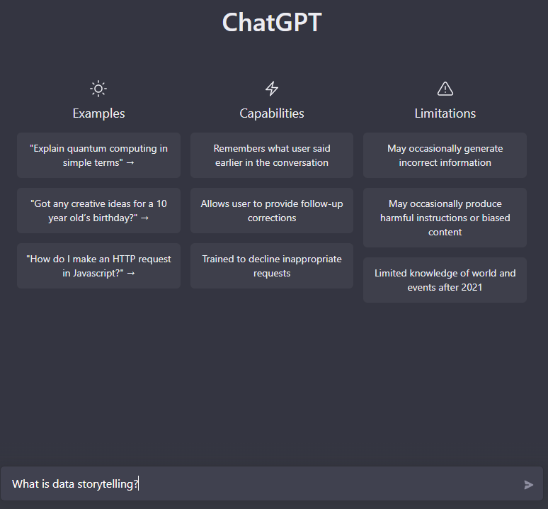
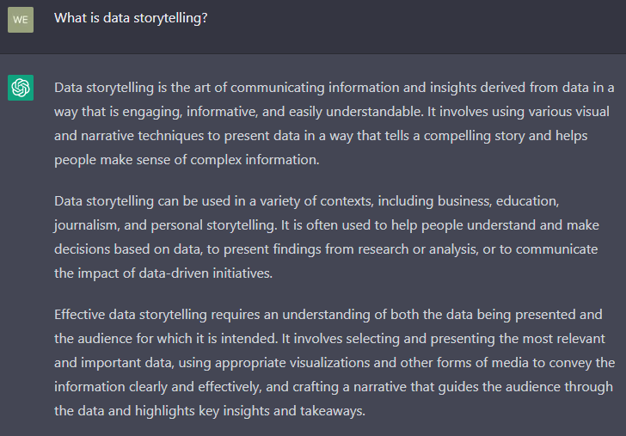
What is Data Storytelling?
Let’s do what any good data scientist would do and ask the AI…

Slide 17
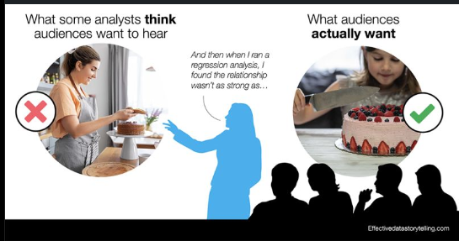
Key Points for Storytelling
Engaging & informative – a compelling story makes it easier to make sense of complex information
Requires understanding of both the data and the audience
Takes the listener through the journey, doesn’t just present a conclusion
Anticipates questions, objections, and actionable next steps
Effective visualizations that get the point across in a direct & succinct manner
Notes:
Know the data… but not just the data! Also think of an audience’s context for that data

Slide 18
A tale of two data stories
Sales are down, so WidgetCo asked their Analytics team to dive into the data and determine what was happening…
Team “Short Story” Presents their findings:
We identified that overall sales are down because we sold less sprockets in March
The sprocket team should do a promotion to boost sales
Team “Storytellers” Presents theirs..
We analyzed sales data across 3 major categories for the last 3 months
As part of this, we noticed an inverse relationship between sprockets and widgets+gears
Partnering with the production team, we came to understand our largest customer orders our parts just-in-time
We recommend a sales-incentive that helps level out each category, providing more predictability & reducing burden on production to ramp-up/ramp-down lines

Slide 19
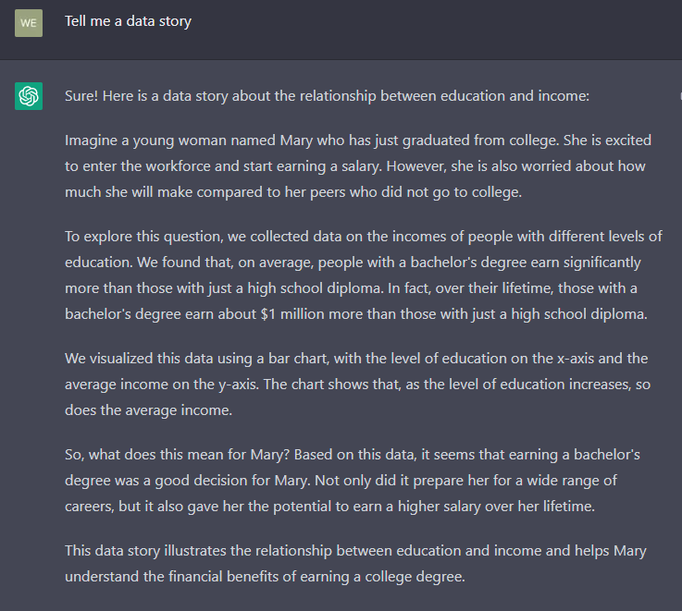
Or we can ask the AI again…

Slide 20
Being a data author
Start with the end in mind, but don’t forget the journey
What do you want the story to convey and what should the audience do after hearing it?
Walk through your story, “I started with this, I then noticed this, so I investigated this..”
Use visualizations appropriate for the message and data
Line chart for trends, bar charts for category comparisons
Use visuals to make a message “pop” and provide support to your narrative
Don’t overwhelm the audience with data, but do use key points
You may need a “Choose your own adventure” version
Craft the story for the audience and what they will care about
Sometimes the audience will want interactivity – amazing insights can come from this type of discovery work

Slide 21
Crafting an “executive summary” presentation
Start with the important facts up front
Why are we here?
What is your key message?
What actions/input do you need from the audience?
Just because it’s a summary doesn’t mean forget good storytelling
This is the “Craft for the audience” piece of storytelling.
Short & concise, but the audience still needs to go on the journey with you
Don’t fall into the trap of “walls of text” to keep to a slide count… instead, make every slide count!
Better to have several slides that each make a point than 1 slide that’s hard to understand

Slide 22






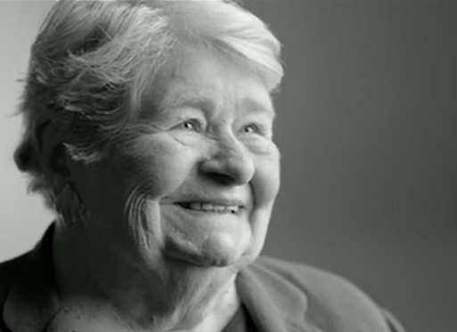

Thank you for the time!
Most of our customers seem to be thoughtful go-getters, ambitious, active & social.
Technology excites them!
They buy across categories, channels and price points —
but they need & want help with technology.
22

